Slide 1


Top Discriminator Efficiencies (shape comparison) NTUA
Giannis Papakrivopoulos
George Bakas

Slide 2
Overview
Efficiencies vs all variables
mTTbarParton
ptTTbarParton
yTTbarParton
partonPt
partonEta
Yields for all samples for all variables
Categories:
1. Both jets are top tagged and b tagged
Cuts:
Reco:
nJets > 1,
|jetEta| < 2.4 (both jets)
jetPt > 400 GeV (both jets)
120 GeV < jetMassSoftDrop < 220 GeV (both jets)
Parton:
|etaParton| < 2.4 (both partons)
ptTopParton > 400 GeV (both partons)
mTTbarParton > 1000

Slide 3
Efficiency shapes between Nominal MC and MTT samples
I noticed that the shape between mtt samples and nominal sample is not consistent when invoking a Medium b tagging cut, where in the loose b-tagging category the shapes seem to be consistent
1st part:
Mva 0.2, Loose btag
Mva 0.3, Loose btag
Mva 0.4, Loose btag
2nd part:
Mva 0.2, Medium btag
Mva 0.3, Medium btag
Mva 0.4, Medium btag

Slide 4
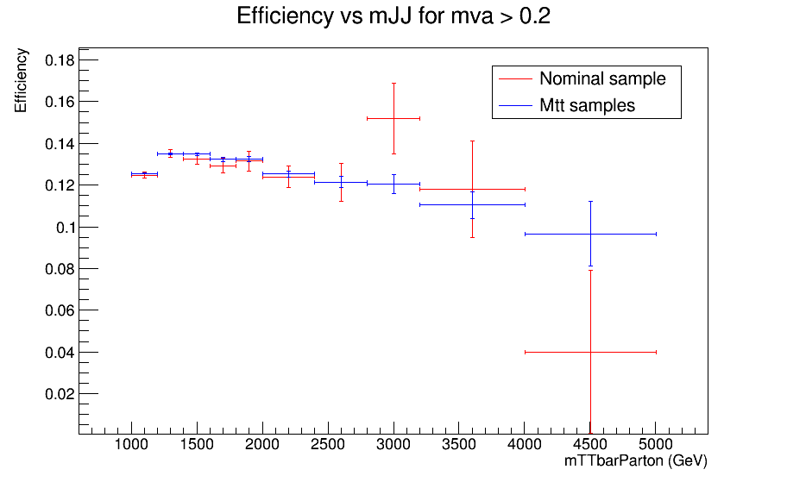
Mva Cut > 0.2 and Loose b-tagging

Slide 5
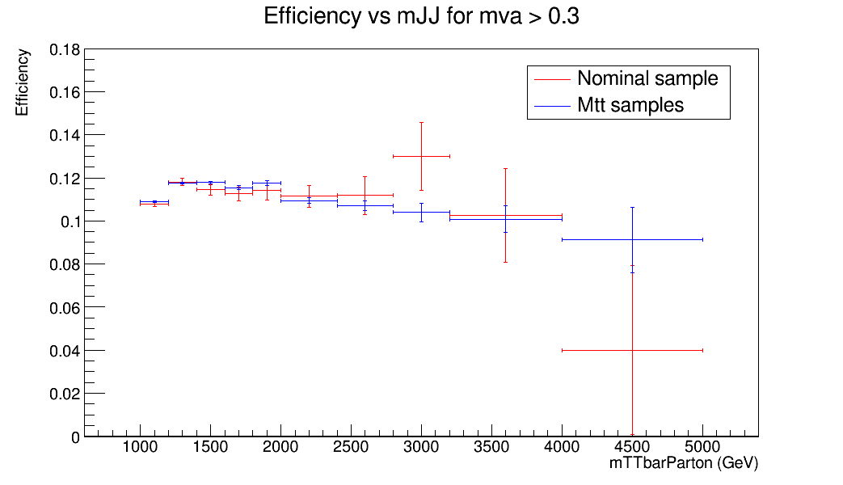
Mva Cut > 0.3 and Loose b-tagging

Slide 6
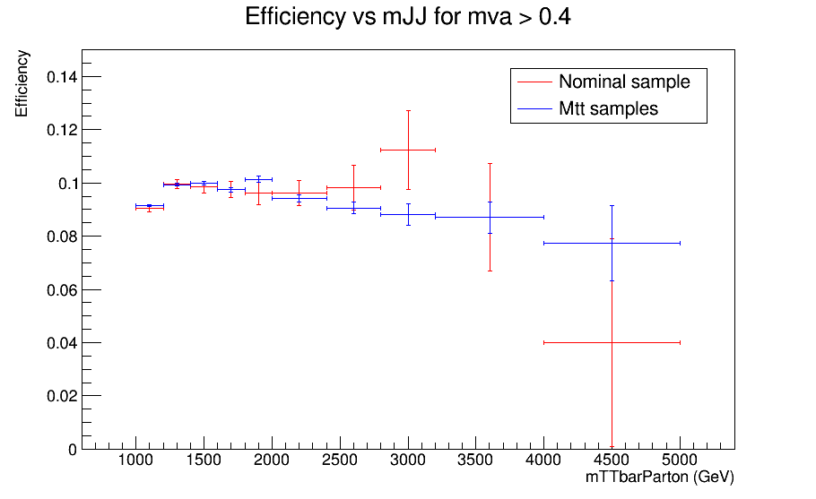
Mva Cut > 0.4 and Loose b-tagging

Slide 7
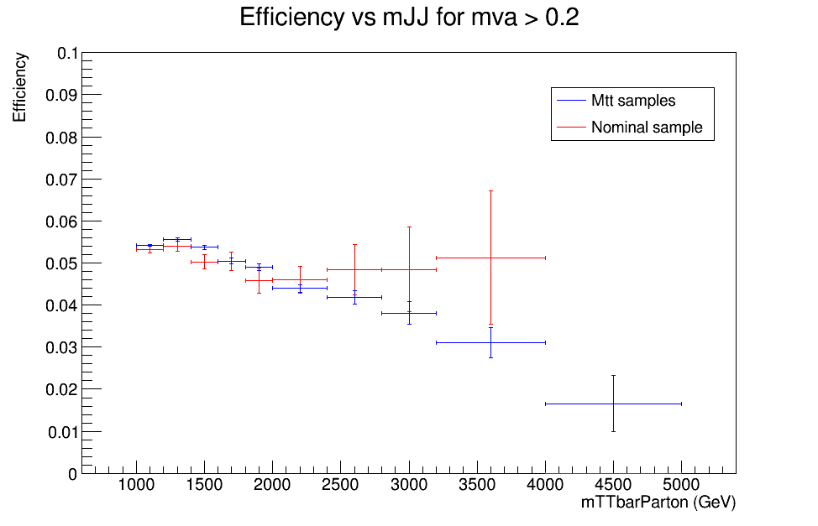
Mva Cut > 0.2 and Medium b-tagging

Slide 8
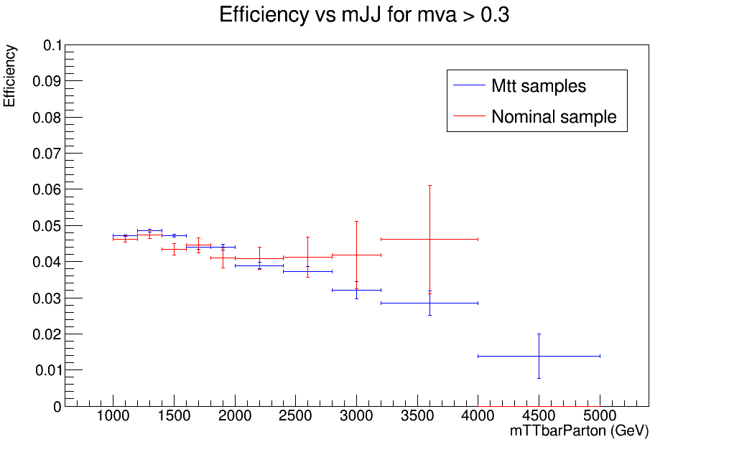
Mva Cut > 0.3 and Medium b-tagging

Slide 9
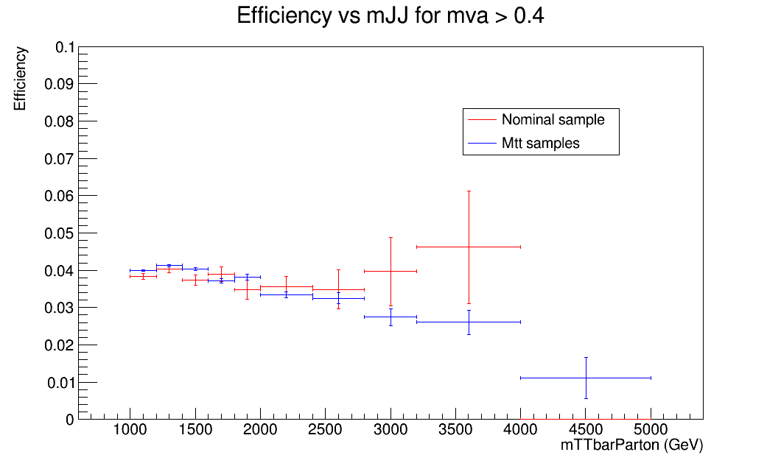
Mva Cut > 0.4 and Medium b-tagging

